Slide 1
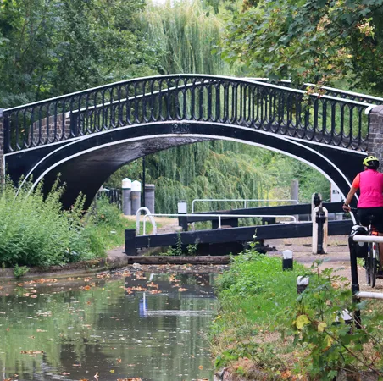
Eco-Moorings Project Update
Pedro Abreu
Climate and Environmental Panel
20 November 2024

Slide 2
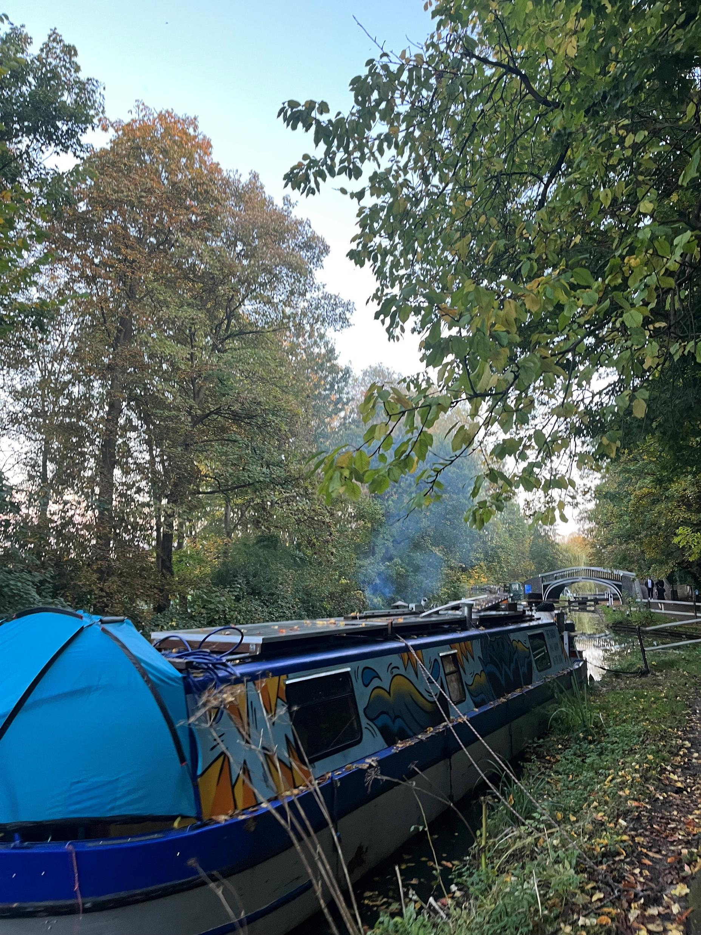
Background
Aristotle Lane is an area of our waterways were the Council experiences recurrent smoke nuisance complaints associated with solid and diesel fuel burning by boaters.
The burning of solid fuels causes a significant health impact on visitors, residents, and particularly boaters who often lack any cleaner alternative to solid fuel burning.
£192,993 received from DEFRA’s Air Quality Grant 2022/2023 to install eco-moorings at Aristotle Lane.
The eco-moorings project will support boaters to adopt cleaner energy behaviours.

Slide 3
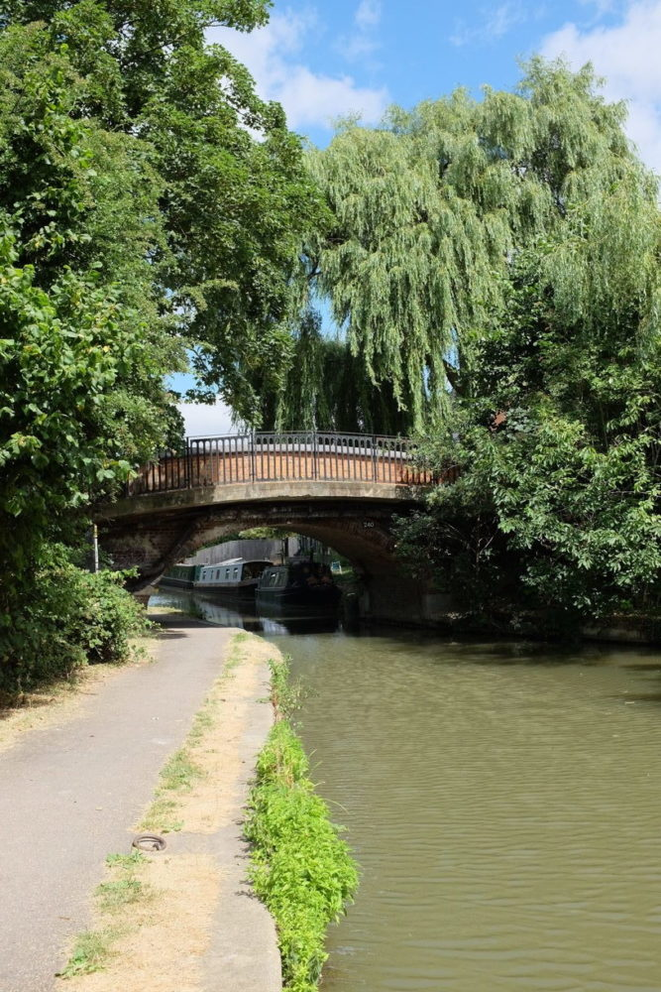
The Project
The Council and Canal & River Trust are partnering to instal eco-moorings that will provide electricity for up to 6 moored vessels at Aristotle Lane.
These are essentially charging points that narrowboats can plug into for their electrical and energy needs (similar to charging an electric vehicle).
There will be 5 x 16amp sockets
1 x 32 amp socket available to test e-propulsion

Slide 4
Expected Outcomes
Reduced level of exposure to air pollutants by residents, towpath users and commuters.
Contribute to a reduction of smoke nuisance complaints by residents in this area of the city.
Contribute to an overall reduction in air pollution with the city of Oxford, particularly PM10 & PM2.5.
Link this project to OCC’s already launched wood burning campaign “Do You Fuel Good?”and also to a much wider engagement piece that is being developed for the boating community.

Slide 5
Timelines
April 2023: Grant funding awarded
October 2023: Partnership agreement signed between OCC & CRT
January 2024: Agreed final design specifications for installation
February 2024: Project proposal submitted to planning system under General Permitted Development - Condition B.1A (1)
September 2024: Procurement exercise finalised and Contractor appointed by the Trust

Slide 6
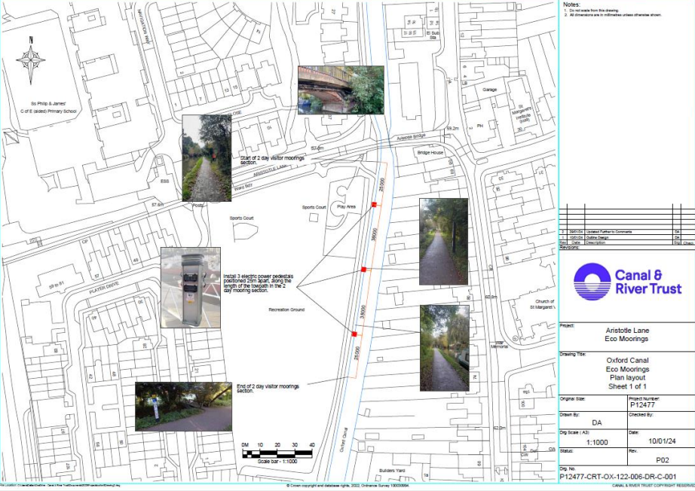

Slide 7
Next Steps…..
TTRO application
November 2024:
Waiting confirmation from contractors on their work programme.
Submission (to County) of TTRO application requesting temporary closure of the towpath (as it’s a public right of way)
December 2024:
Expected commencement of installation works
January 2025:
Expected completion

